Slide 1
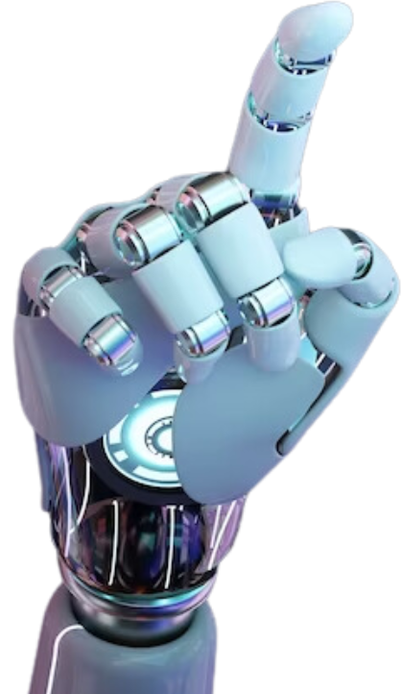

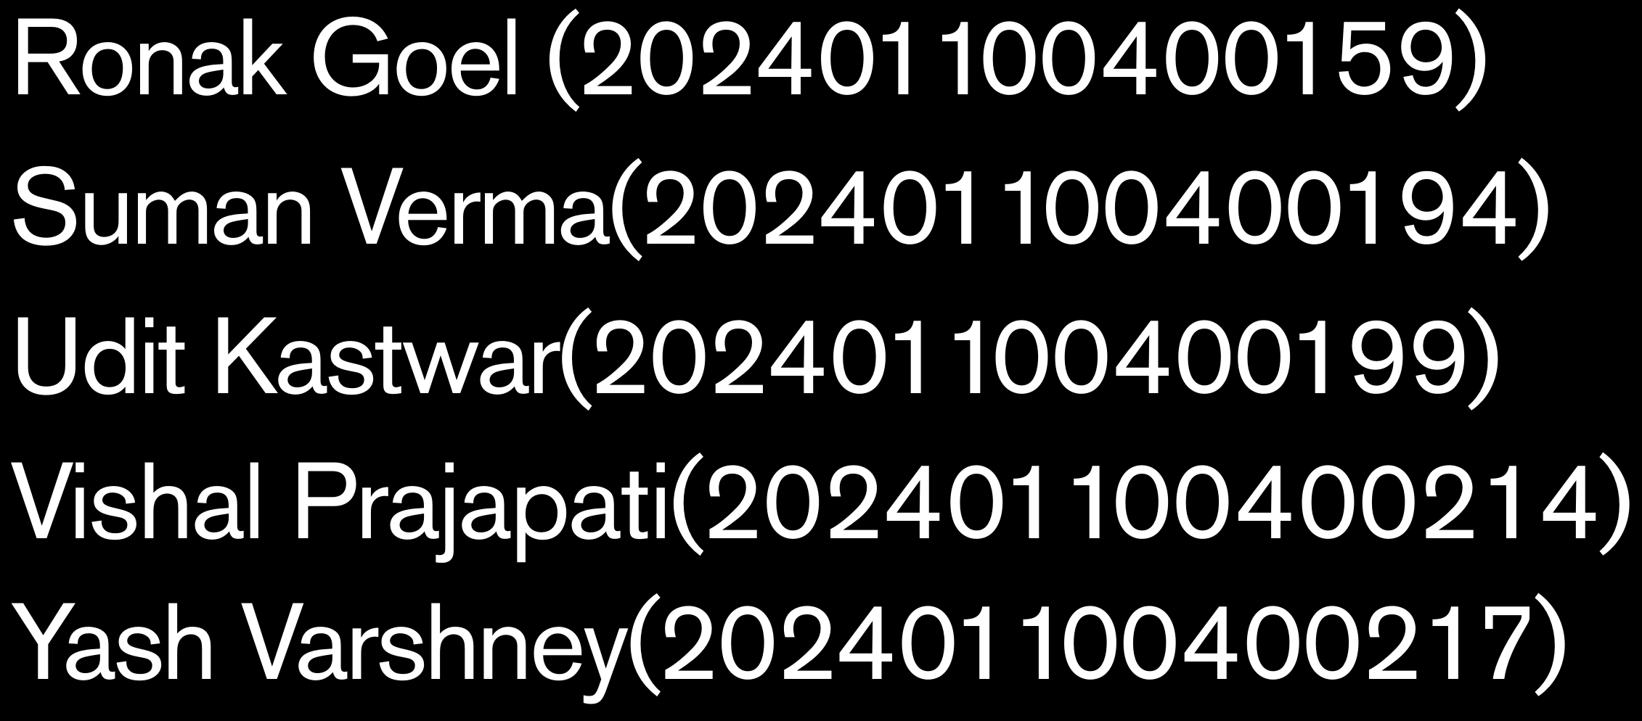


Slide 2

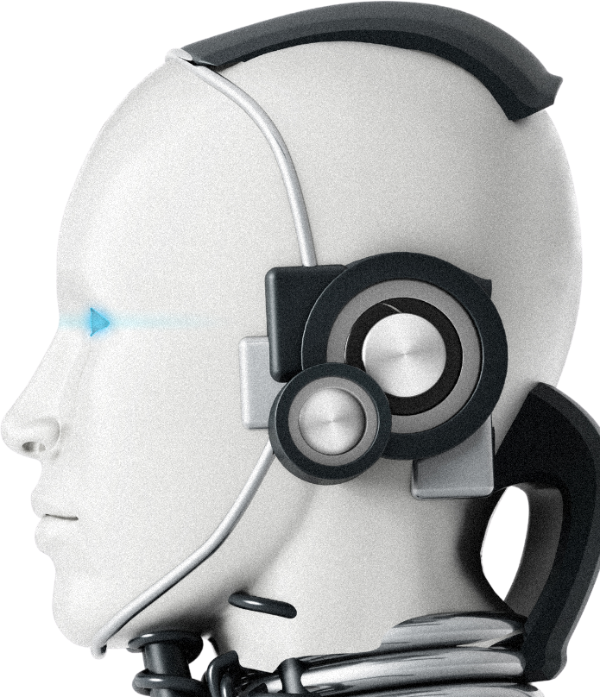
Brain tumors are life-threatening and require early detection for better treatment outcomes.
MRI (Magnetic Resonance Imaging) is a widely used technique for brain tumor diagnosis.
Manual diagnosis from MRI images is time-consuming and prone to human error.
Convolutional Neural Networks (CNNs) excel at extracting features from images for accurate classification.
This project aims to automate brain tumor detection using CNN-based image classification.

Slide 3


Problem Statement
Objective: Develop a CNN model to classify MRI images into tumor and non-tumor.
Challenges in manual diagnosis. Automation to assist radiologists.

Slide 4

Convolutional Neural Networks (CNN)
What is CNN?
How it Works:
A type of deep learning model
It uses layers like Convolution,
specifically designed to
process and analyze image
ReLU, Pooling, and Fully
Connected layers to extract features and classify images
data.
Why CNN is Important in This Project:
Automatically detects patterns like tumors in MRI images.
Reduces need for manual feature extraction.
Provides high accuracy in medical image classification.

Slide 5

Dataset
Source:
Classes:
The dataset contains MRI brain scan images collected from
Images are categorized into two main classes — Tumor and No
open-source platforms like
Tumor.
Kaggle or medical databases.
Size & Diversity:
Preprocessing:
Contains several hundred to
Images are resized, normalized,
thousands of images with varying sizes, angles, and tumor types for
and optionally augmented to improve model performance and
better generalization.
training speed.
Kaggle Dataset Used
AI opponents in video games employ adaptive
strategies and behaviors to challenge players.

Slide 6
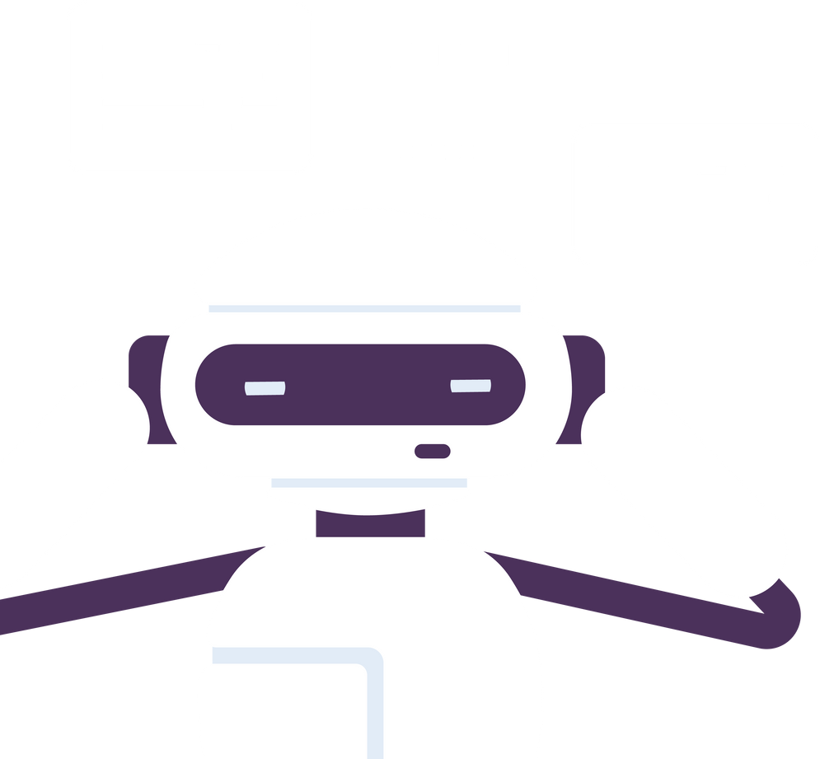
Methodology
Data Collection:
Data Preprocessing:
Resizing all images to 150x150 pixels. Normalizing pixel values to a 0–1 scale.
MRI brain scan images
collected from a labeled public dataset (e.g., Kaggle).
Splitting data into training and validation
sets (80/20).
Model Building:
Customer Service
Constructing a CNN with convolutional,
pooling, and dense layers.
Chatbots provide automated customer support and
Using ReLU activation and sigmoid for
binary classification.
assistance in various
Compiling the model with Adam
industries.
optimizer and binary cross-entropy loss.
Model Evaluation:
Monitoring training and validation accuracy/loss across epochs. Visualizing results using graphs and sample predictions.
Analyzing model performance with confusion matrix and test images.

Slide 7
Output/Result

Slide 8
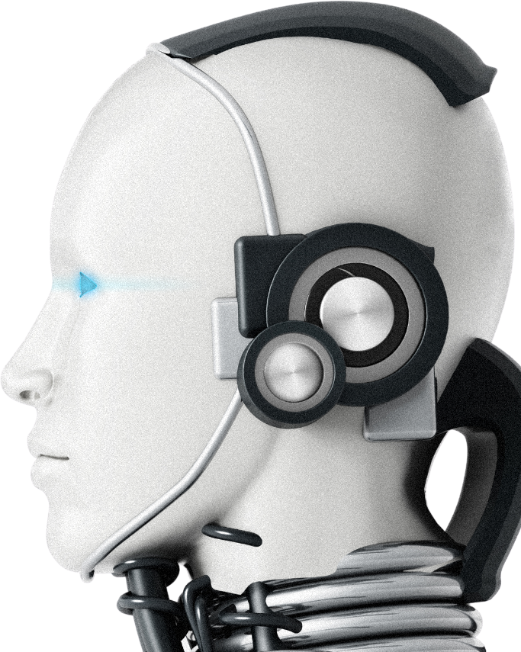
Thankyou

